Slide 1

Match Making Model PIZZAZ.COM
Rashmi Kalra
Exam 2 – STA 512

Slide 2
Agenda
Introduction
Data Understanding
Variable Correlation
Model Development
Model Performance
Additional Findings

Slide 3

1. Introduction
Problem Statement
PIZZAZ.com wants to break into online dating industry that uses the power of statistics to optimally match couples which will help business to maximize matches and improve customer experience
The company wants to build a statistical model to predict the daters opinion of the person they are dating based on the other factors- attractiveness, sincerity, intelligence, fun, ambitiousness, and shared interests of their partner
The model will be used by PIZZAZ.com to show people who closely match with each and would predict the likelihood of dater liking the other person
The other things to look at:
Accuracy of model predicted Like rating to the actual Ratings
If Age or Race are important underlying factors for the final rating
Situations where like ratings are suspiciously high

Slide 4


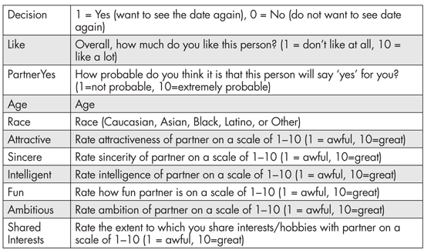
2. Data Understanding
To achieve the target, a speed dating event was conducted where 276 couples were randomly paired up with one another for a short speed date and the results were recorded
The below data was captured separately for males and females and recorded in different variables
Target Variable
Independent Variables

Slide 5
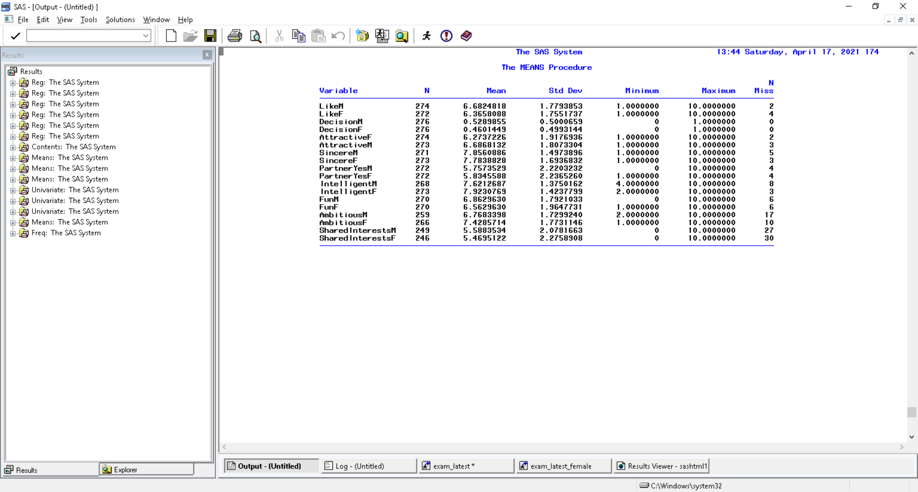
2. Data Understanding Contd...
Variable with suffix ‘m’ is male’s rating for female and vice versa
It is observed from each characteristic that average responses of males are slightly different than females
Considering this, 2 different models were developed 1 for male and 1 for female to ensure the accuracy of model

Slide 6
3. Variable Correlation
Variable correlation analysis was performed and it is observed that
For males, highly correlated variables are Attractive and Fun
For females, Attractive, Fun and shared Interest
Additional variables were created by polynomial transformation and interactions between different raw variables

Slide 7
3. Model Development
Sampling
Linear Regression
Model Accuracy check using MAE/RMSE
Model reliability using R square
Linear Regression using following steps
Training (70%)
Hold-out (30%)
Multi-collinearity Checks
All possible method
Forward Selection
Backward Selection
Stepwise Selection
VIF method
Condition Index
Steps for model development
Data Preparation
Variable Selection I
Regression Diagnostics
Final Model Equation
Model Validation
Model Equation for Male
Model Equation for Female
Co-efficient | Variable (Ordered by Importance)
0.889 | Intercept
+ 0.548 | Attractivem
+ 0.198 | sincerem
+ 0.14896 | Funm_c (Centralized)
+ 0.1176 | SharedInterestsm
- 0.109 | I10_c (Interaction: Fun and Intelligence)
- 0.02632 | Intelligentm_c (Centralized)
Co-efficient | Variable (Ordered by Importance)
0.43128 | Intercept
+ 0.32200 | Intelligentf
+ 0.29911 | attractivef
+ 0.25149 | funf
+ 0.18078 | sharedinterestsf_c
- 0.02842 | sharedinterestsf_2c (Quadratic Term)

Slide 8
4. Model Performance
Model Accuracy Checks
Male Model
Female Model
Metric | Value
Mean Absolute Error
Root Mean Squared Error
Metric | Value
Mean Absolute Error
Root Mean Squared Error
Model Reliability
Male Model
Female Model
Metric | Value
R Square
Shrinkage
Metric | Value
R Square
Shrinkage

Slide 9
5. Additional Findings
Impact of Race on Dater’s Response
121 couples that belonged to same race
I created the dummy variables for same race, (if same race, then 1, else 0)
Hypothesis testing if race has significant relationship with Like outcome and found that for both males and females, there is no significant relationship between a partner of same race on the final outcome
Impact of Age on Dater’s Response
111 were of close age group(+/-2yrs)
I created the dummy variables close age (if age difference is +/- 2 years, then 1, else 0)
Hypothesis testing if close age has significant relationship with Like outcome and found that for both males and females, there is no significant relationship between a partner of same race on the final outcome
Checks for suspicious cases where ratings have been inflated
Performed residual analysis between actual and predicted values (>2 and like ratings with 9 or 10)
Found that following observations of male ratings are higher than expected:
And for females, the suspicious obsevations are ….

